Slide 1

Unsupervised Machine Learning on Probability Distributions
Clustering Data Distributions Using Empirical Probability Means
Brandon Sams
Friday, May 14th 2021

Slide 2
A Round of “Thank You”s
The Audience
Schweitzer Engineering Laboratories
Bellevue University

Slide 3
Overview
Examination of the generalized EP-Means Method
K-Means
Translation to EP-Means
Flight Dataset
Cleaning and Exploration
Implementing EP-Means
Earth Mover’s Distance
Cluster Centroid
Initial Clusters
Results

Slide 4
Understanding EP-Means

Slide 5
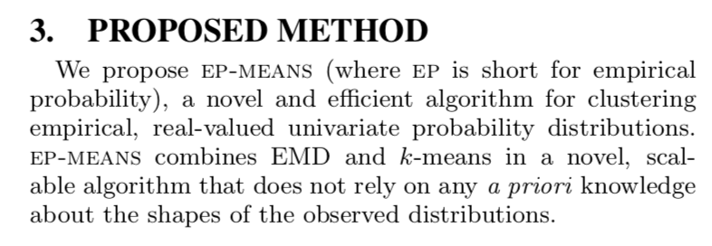
Understanding EP-Means
Henderson, K., Gallagher, B., & Eliassi-Rad, T. (2015). EP-MEANS: An efficient nonparametric clustering of empirical probability distributions. Proceedings of the 30th Annual ACM Symposium on Applied Computing, 893–900. https://doi.org/10.1145/2695664.2695860

Slide 6
Clustering: Defined
Unsupervised Machine Learning Problem
Partitions a dataset into parts (clusters)
All data in a cluster is similar
Data in different clusters should be as different as possible
Each cluster has a "center"

Slide 7



Clustering: Use Cases
Document Clustering
Image Segmentation
Market Segmentation
Recommendation Engines

Slide 8
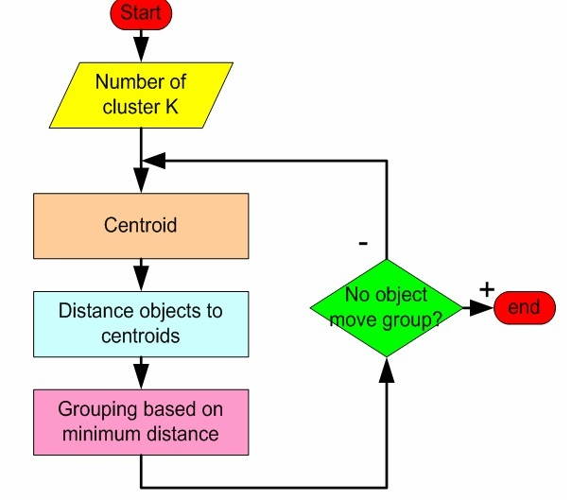
K-Means Clustering

Slide 9
K-Means
Relies on:
Distance between data and Centroid
Centroid computation

Slide 10
Translation to EP-Means
Distance Metric:
Earth Mover’s Distance
Area Between Cumulative Distribution Functions

Slide 11
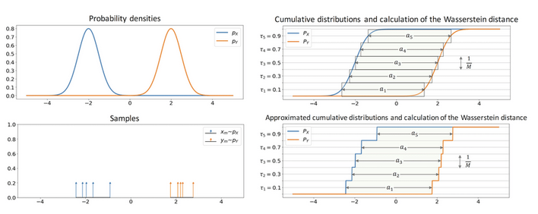
Earth Mover’s Distance (Wasserstein Distance)

Slide 12
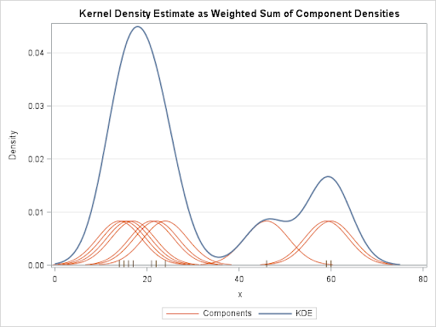
Translation to EP-Means
Centroid Computation:
Simple average of Probability Density Functions (PDFs)
Similar to Kernel Density Estimation
Result is normalized to a new PDF

Slide 13
EP-Means Clustering
Choose initial cluster centroids
Group distributions from dataset by using the minimum Earth Mover’s Distance
Recompute the centroid distributions
If the centroid distributions no longer change, then the process is complete

Slide 14
Flight Dataset

Slide 15
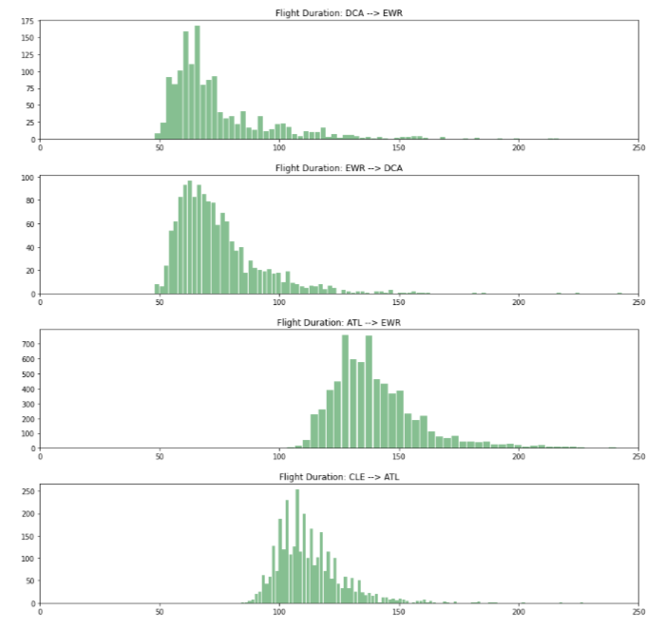
Flight Data
Flight Duration
Probability Distribution for each route
Bureau of Transportation
2009-2018 data

Slide 16
Flight Data: Exploration
https://www.kaggle.com/yuanyuwendymu/airline-delay-and-cancellation-data-2009-2018
Came as .csv files, one per year
7.1 GB
Each row contains data for a flight
27 fields in the dataset

Slide 17
Flight Data: Fields
FL_DATE
OP_CARRIER
OP_CARRIER_FL_NUM
ORIGIN
DEST
CRS_DEP_TIME
DEP_TIME
DEP_DELAY
TAXI_OUT
WHEELS_OFF
WHEELS_ON
CARRIER_DELAY
WEATHER_DELAY
NAS_DELAY
SECURITY_DELAY
LATE_AIRCRAFT_DELAY
TAXI_IN
CRS_ARR_TIME
ARR_TIME
ARR_DELAY
CANCELLED
CANCELLATION_CODE
DIVERTED
CRS_ELAPSED_TIME
ACTUAL_ELAPSED_TIME
AIR_TIME
DISTANCE

Slide 18
Flight Data: Cleaning
FL_DATE
OP_CARRIER
ORIGIN
DEST
CRS_ELAPSED_TIME
ACTUAL_ELAPSED_TIME
AIR_TIME
DISTANCE
Ten .csv files, one per year
Each row was a flight
Loaded them as 10 dataframes
Append dataframes together
Basic cleaning
Remove extra columns, and keep ones to the right
Add a ROUTE column
Remove rows with missing data
Remove routes with less than 1000 flights
Save back to a .csv file

Slide 19
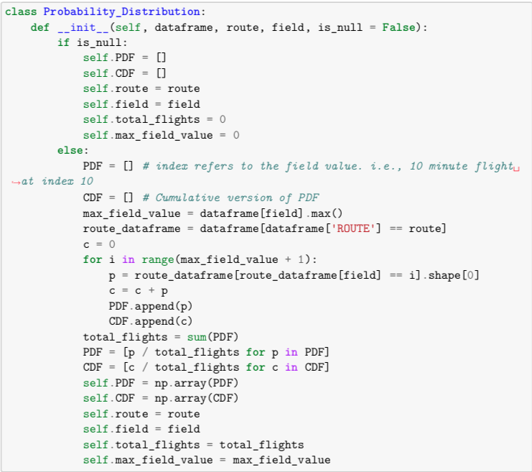
Constructing a Distribution
Given the large dataframe, make a distribution for each route
Created a Probability Distribution Class in Python
Each distribution has a PDF and a CDF

Slide 20
Implementing EP-Means with Flight Data

Slide 21
Implementing EP-Means
Wrote a function that can compute Earth Mover’s Distance for two distributions
Iterate through each possible flight duration
See how far apart the CDFs are at that point
Add to a running total
return the total
Runs very quickly

Slide 22
Implementing EP-Means
Wrote a function that can construct a centroid distribution for a collection of distributions fed in as input
Iterate through each possible flight duration
Find the average value of the PDF at that point
Add the average value to the resulting distribution’s PDF
Calculates the CDF as well
Return the centroid distribution
Runs slowly

Slide 23
Implementing EP-Means
Choosing Initial Cluster Centroids:
K-Means does not require initial clusters be chosen in any special way
Random choice is okay, but choosing poorly can lead to poor results
2 options:
Choose carefully (k-means++)
Run K-Means many times

Slide 24
K-Means++
Given all the data, compute the centroid. This is the first cluster center.
From the remaining data, using a weighted random choice, choose another point to be the next centroid
Weighted choice favors points which are far from any cluster centers
Repeat until K initial clusters have been defined

Slide 25
Results

Slide 26
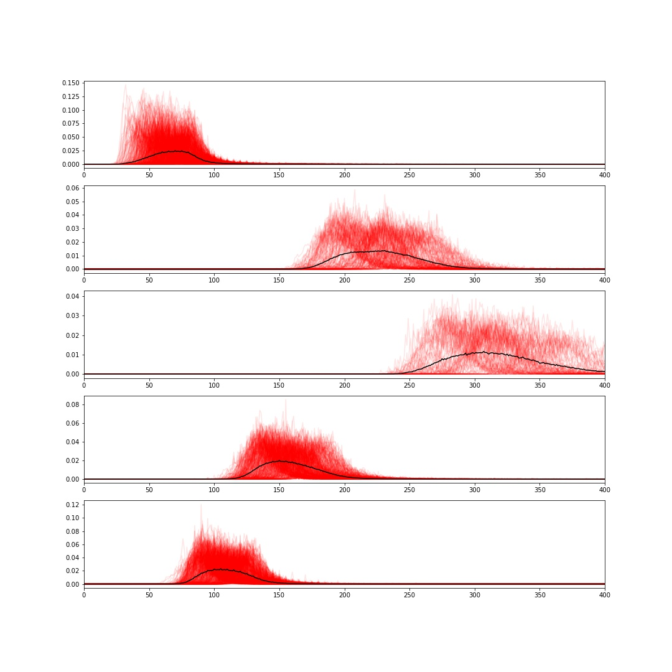
Results
Probability Density Functions
K = 5

Slide 27
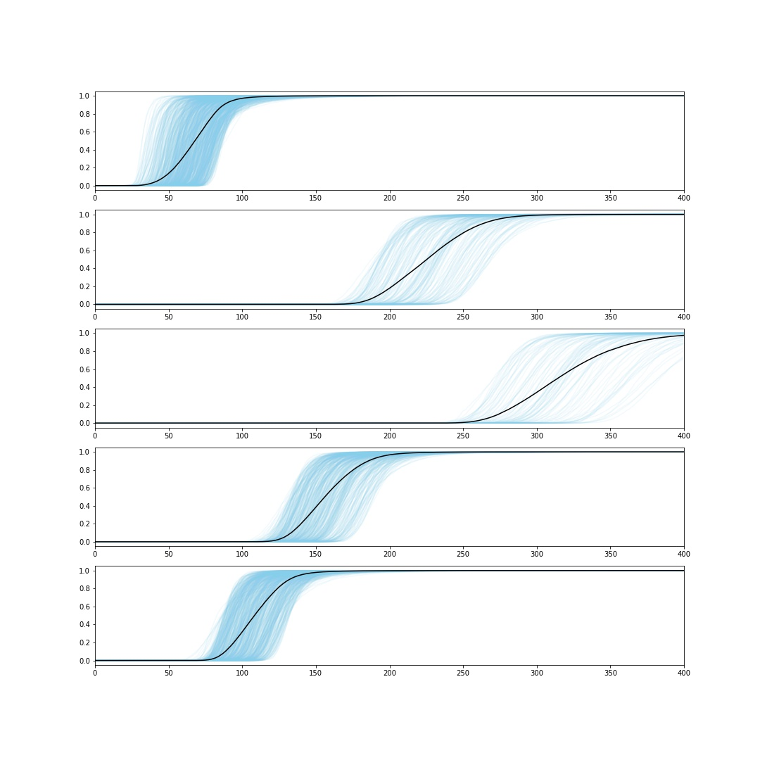
Results
Cumulative Distribution Functions
K = 5

Slide 28
Measuring Error
Error can be measured in total Earth Mover’s Distance between each distribution and its respective cluster centroid
“Intra-Cluster Distance”

Slide 29
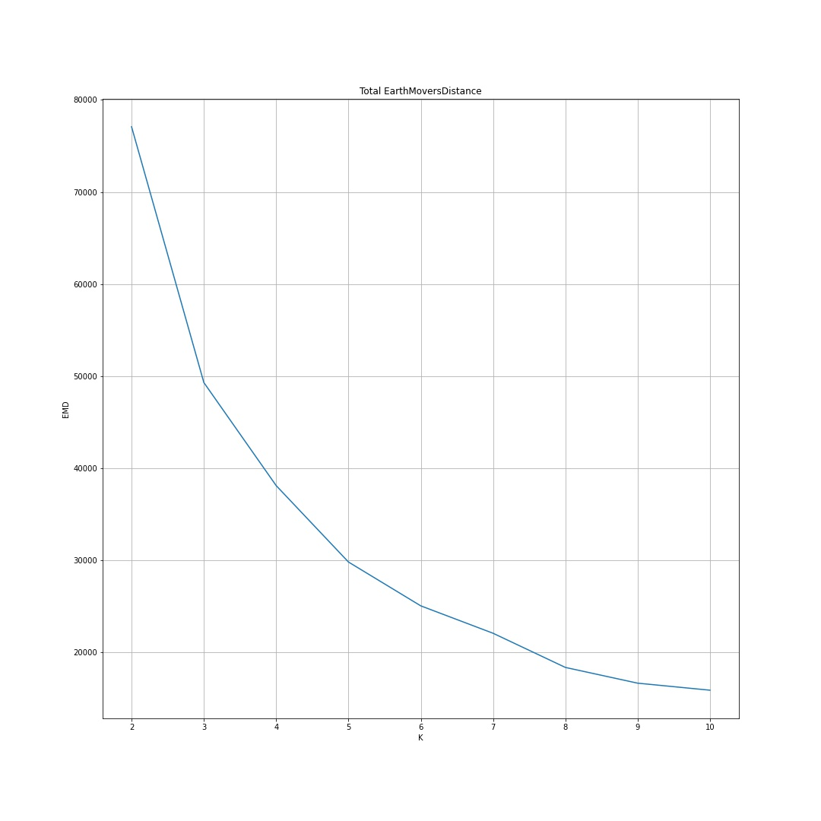
Other Values of K
Clustering was run for values of K between 2 and 10
Expected that error would drop as K increased
K=5 appears to be the ”Elbow Point”
Past K=5, the error doesn’t drop near as fast

Slide 30
Review
Understanding EP-Means
K-Means
Translation to EP-Means
Flight Dataset
Cleaning and Exploration
Implementing EP-Means
Earth Mover’s Distance
Cluster Centroid
Initial Clusters
Results

Slide 31
Conclusion
EP-Means:
Benefits:
Very fast
Can be optimized by choosing initial clusters carefully
Does not assume the distributions to be in a certain shape
Drawbacks:
Very specific use case
Flight routes can be clustered in accordance with the distribution of their durations

